Slide 1

Business Card Studies
Sixteen directions for Kelly Mortazavi
AVINA Wellness . Round 1 + Round 2

Slide 2
What I did, and why
Round 1 . Ten studies, gravitas register
Round 2 . Six in your watercolor aesthetic
Built from your AVINA Brand Pack v0.1: graphite, ivory, ochre, classical serif,
generous whitespace, single-accent layout. The calling-card register that
Sienna Charles, Knightsbridge Circle and family-office firms use.
Why: this is the positioning sentence "the private office of your life"
expressed visually. Quiet, anchored, premium-by-restraint.
Strength: communicates seriousness, discretion, gravitas. Reads like
a private bank or law firm, not a wellness studio.
Risk: too austere. May read as too corporate / too male for the actual
client warmth Kelly delivers in person.
Built from the directions you sent through: blush + dusty grey watercolor
washes, bronze typography, your portrait in an arched frame matching the
logo emblem, decorative cross dividers, soft and personal.
Why: this is the warmth Kelly actually brings. The brand pack underweighted
this. Your reference is closer to where the brand should land.
Strength: feminine, approachable, recognisably you. Translates trust.
Risk: a touch close to wedding / boutique stationery. The bronze type and
discipline of the layout pull it back to professional.
Two rounds because the right card sits somewhere between the two registers, and you need to see both to choose.

Slide 3
Sources reviewed before designing
AVINA Brand Pack v0.1
Graphite/ivory/ochre palette. Classical serif. "Never Playfair, never Didot." Generous whitespace. Single accent per layout.
AVINA-BOOK assets
Interior photography (drawing room, library, terrace). On-brand. Used for Card 5 photo back.
Avina Wellness website assets
27 site images including portraits and brand ground textures.
Kelly's reference cards
Watercolor washes, bronze type, arched portrait, cross dividers. Clear visual direction from you.
PLAUD strategic transcripts
"Strategic Pivot for Avina Wellness: HNW Clients" + "Stabilizing Avina Home Detox". Tone and positioning context.
Industry benchmark
Sienna Charles, Knightsbridge Circle, The Well, Sollis Health, Hermes calling cards. What wins in HNW concierge: minimum ink, max whitespace, single accent.

Slide 4
Brand foundation applied to every card
Palette
Typography
Graphite
#2B2A27
Headings, type
Hoefler Text
Ivory
#F4EEE3
Card ground
Display + headings. Classical serif, sober, not fashion-magazine.
Baskerville Italic
Cream
#F2EBE2
Round 2 ground
Roles + body. Quiet, humanist, professional.
Ochre
#A87E3F
Round 1 accent
OPTIMA SMALL CAPS
Bronze
#8C6A3F
Round 2 type
City marks, modes, supporting copy.
Blush
#E4D3C8
Watercolor wash
Layout principles
Dusty Grey
#C7C3BB
Watercolor wash
Generous whitespace, never more than 40% of the card inked.
Single accent rule per layout (one ochre line, one bronze cross).
Logo never tilted, washed, or reimagined; placed with one cap-height clear space.
Left or centered alignment, never justified.

Slide 5
Round 1
The gravitas register
Built straight from the AVINA Brand Pack v0.1.
Graphite, ivory, ochre. Classical serif. No photography. No watercolor. No embellishment.
Discretion expressed visually. The cards a private banker would carry.
Each direction below is a different way of saying the same thing: AVINA is serious, quiet, and expensive.

Slide 6
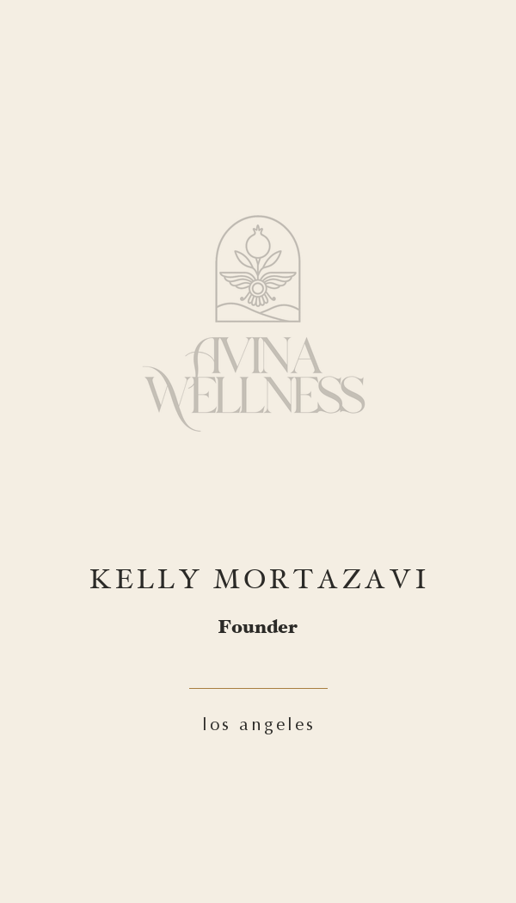
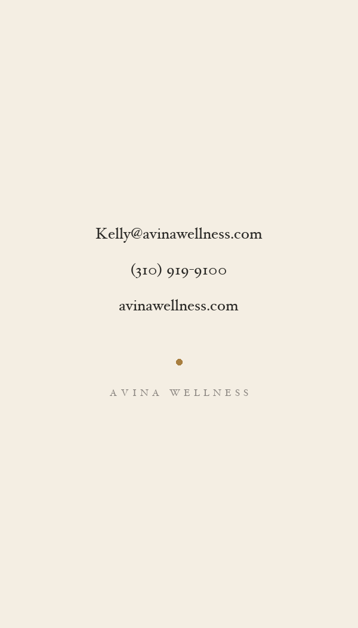
01
The Calling Card
FRONT
BACK
What it does
Pure ivory ground. Logo centered. Name in tracked small caps with role in italic. Single ochre rule. No phone or email on the front; flip for that.
Why
The quietest direction in the set. This is what a private banker, a Beverly Hills lawyer, or a private-office principal would carry. Communicates: I do not need to advertise. Risk: too sparse if you want to convert a chance encounter into a call.

Slide 7
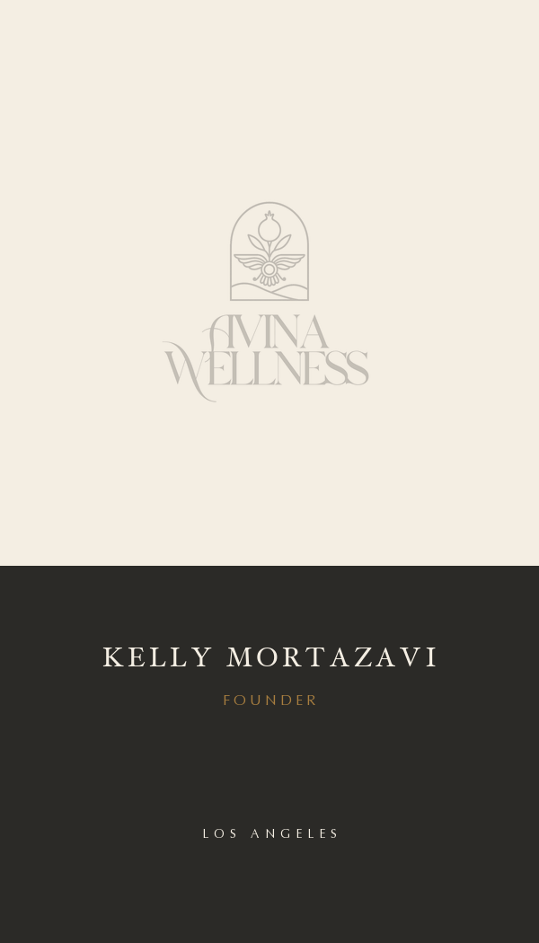
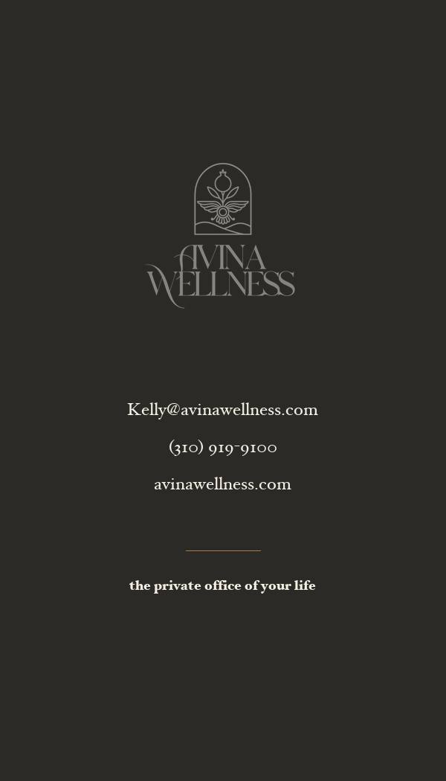
02
Tonal Split
FRONT
BACK
What it does
Top 60% ivory with the logo, bottom 40% graphite block holding name + role. Reverse fully graphite for full contact. Two-tone, editorial.
Why
More confident than 01 without losing restraint. The graphite block reads as 'this person is serious.' Good for HNW male clients (the Post-Exit Founder archetype). Slightly more masculine than the rest.

Slide 8
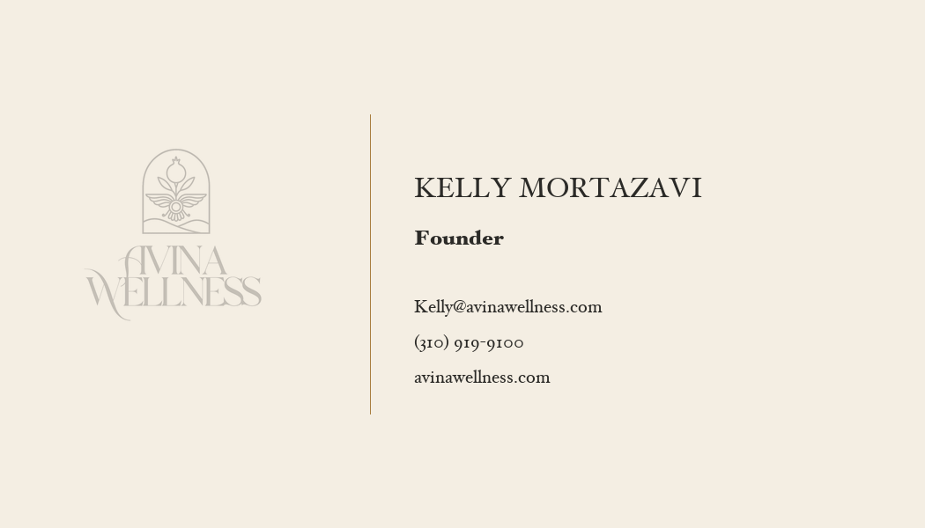
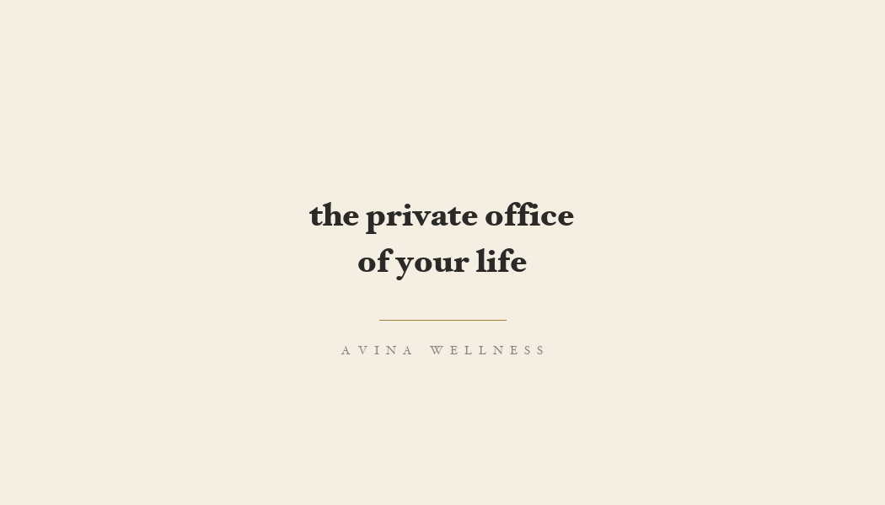
03
Editorial Horizontal
FRONT
What it does
Landscape orientation. Logo locked left. Vertical ochre hairline divides. Name + role + contact stacked right. Reverse holds the brand sentence in italic.
BACK
Why
Magazine-spread feel. Reads like a feature article byline. Good if you want clients to take a moment with the card rather than file it. Landscape is also more memorable in a stack of portrait cards.

Slide 9
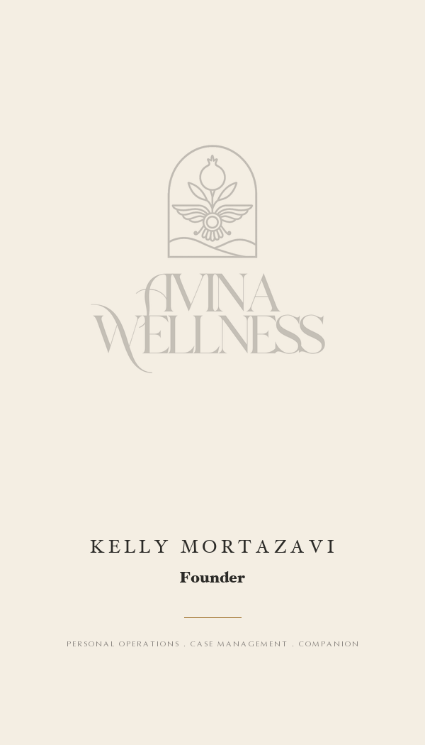
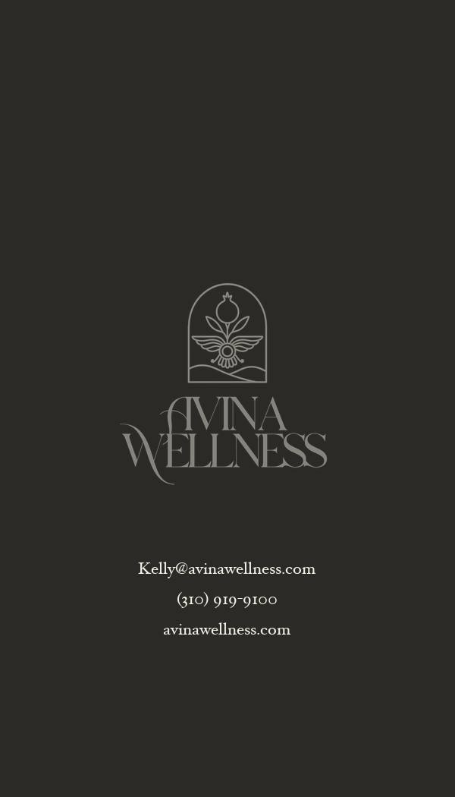
04
The Crest
FRONT
BACK
What it does
Front gives the logo more space than any other layout. Reverse is graphite with logo in ivory plus contact details. The card carries the brand mark, not the person.
Why
When the firm is the asset, lead with the firm. Useful at events where you are introducing AVINA before introducing yourself. Lower personal warmth, higher institutional weight.

Slide 10
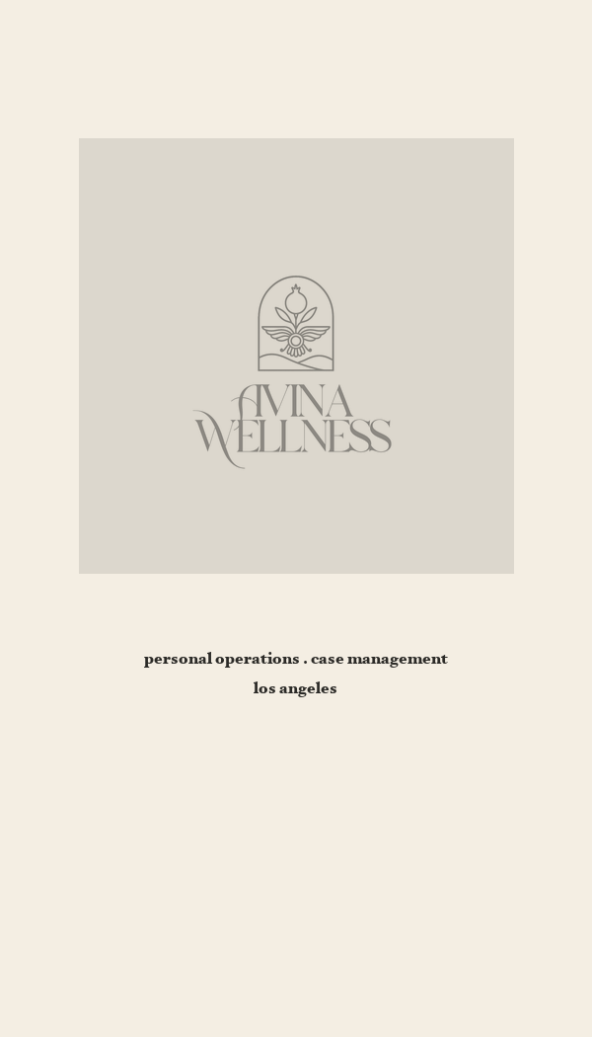
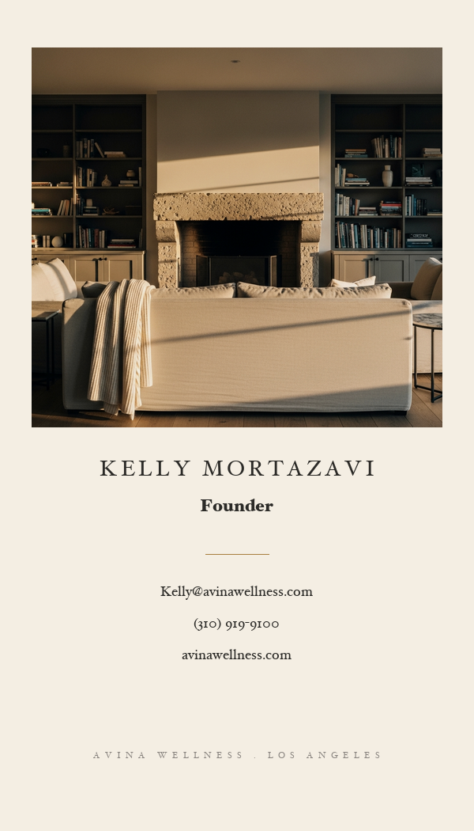
05
Photo Back
FRONT
BACK
What it does
Front: ivory with a soft warm-grey gallery block holding the logo. Reverse: a real on-brand interior photograph (drawing room, evening light) with name and contact below.
Why
The reverse is the seduction. Whoever flips the card sees a quiet, warm, residential interior, not a corporate abstraction. This signals: AVINA happens in homes, not offices. Closest of the ten to the warmth register.

Slide 11
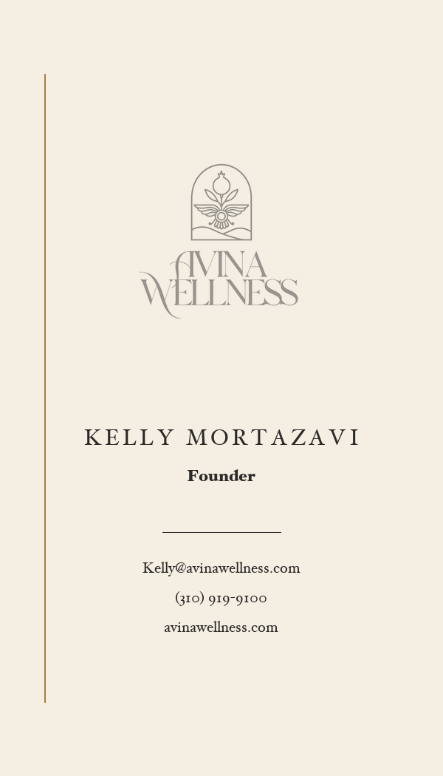
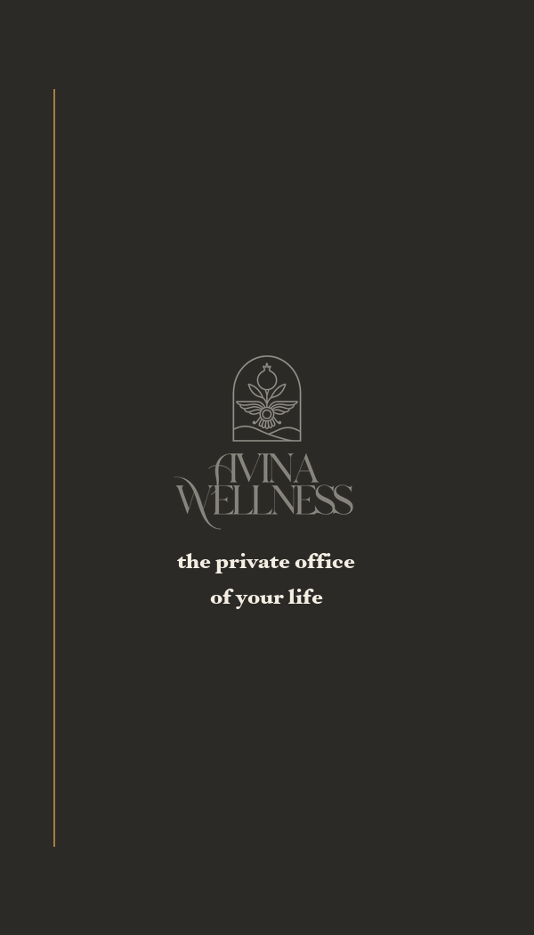
06
Ochre Line
FRONT
BACK
What it does
Single ochre vertical rule down the left edge, front and back. Logo top center, name + role + contact stacked. Reverse carries the same rule with the tagline in ivory on graphite.
Why
Discipline through restraint. The rule does the heavy lifting; everything else is content. This is what a Hermes letterhead would look like if Hermes did wellness. Subtle but unmistakable.

Slide 12
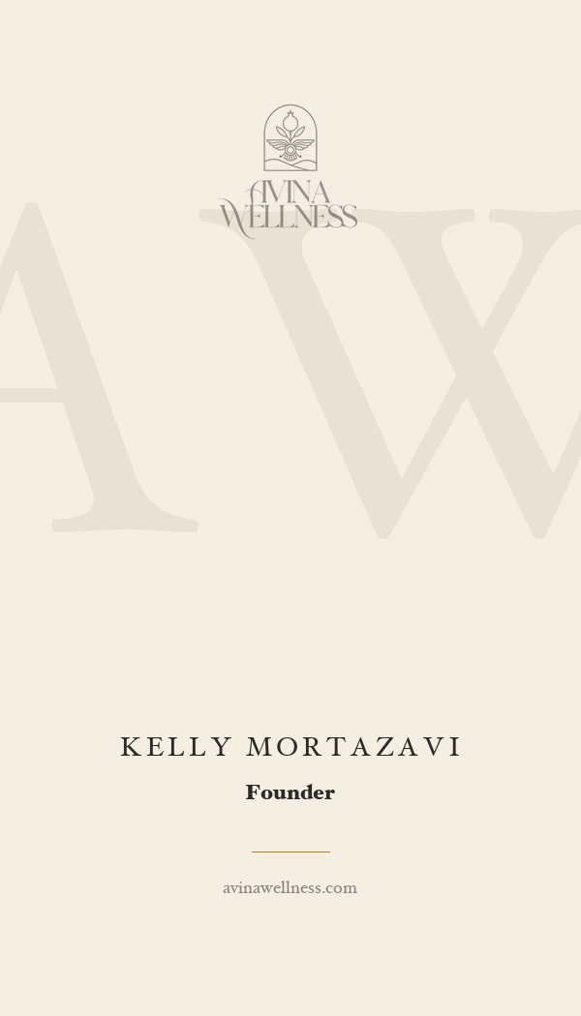
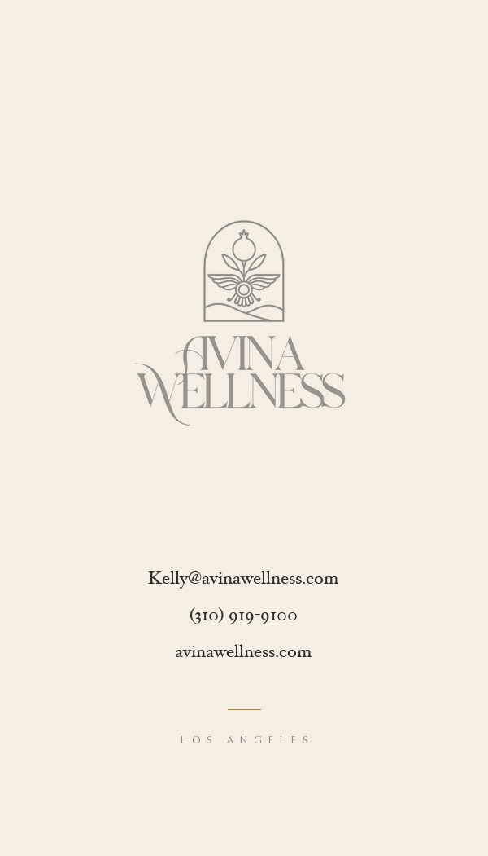
07
Monogram
FRONT
BACK
What it does
A pale 'AW' watermark monogram fills the front, with the actual logo small at top. Reverse is the logo at full size with contact stacked beneath.
Why
Heritage register. Reads like a hotel calling card or a family-office signature. The monogram is the subtle stamp, the full logo on the reverse is the receipt. Best printed on heavier stock so you can feel it.

Slide 13
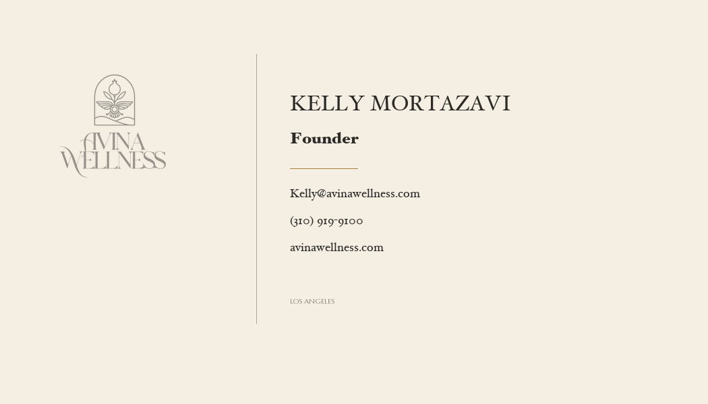
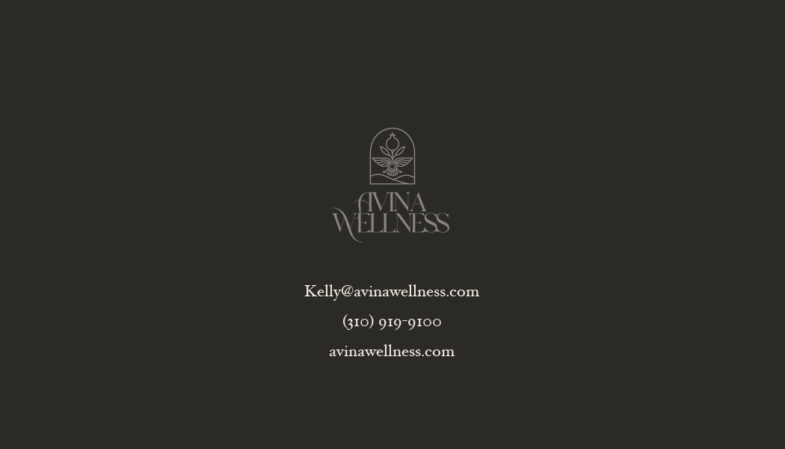
08
Modernist Line
FRONT
What it does
Landscape. Logo small left, vertical hairline, name + role + ochre rule + contact right. Reverse all graphite with logo in ivory and the brand sentence centered.
BACK
Why
Like 03 but tighter and more architectural. The hairline replaces emphasis. This is the most contemporary direction in Round 1, useful if you want to feel current rather than traditional.

Slide 14
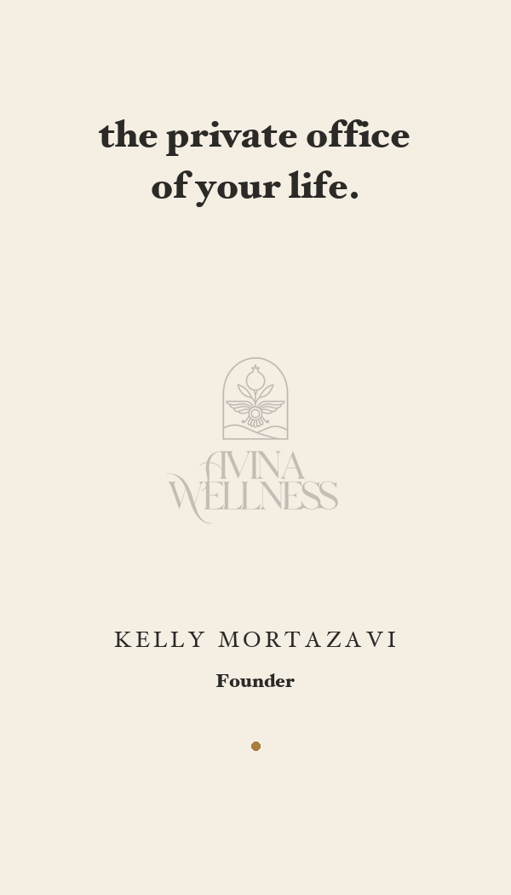
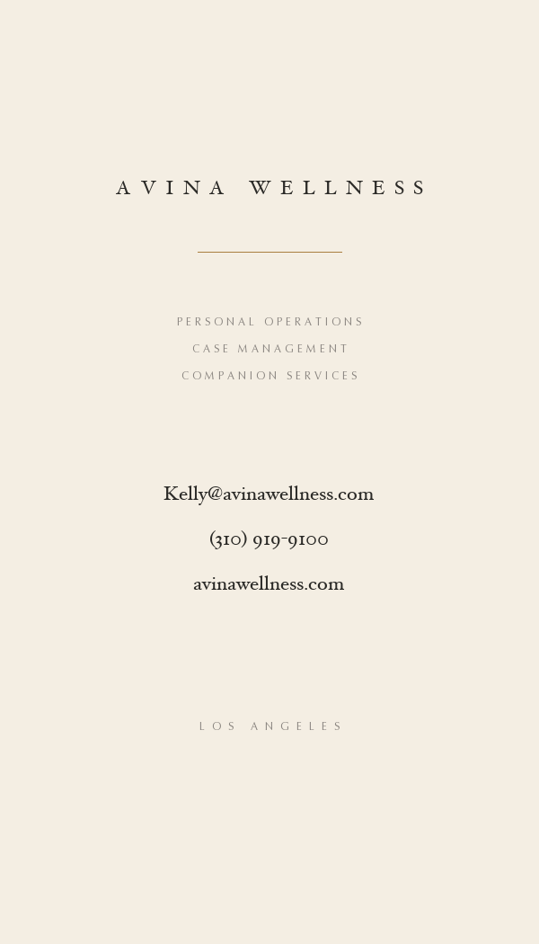
09
Folded Statement
FRONT
BACK
What it does
Top of card: large italic tagline 'the private office of your life.' Logo middle. Name + role beneath. Reverse: AVINA wordmark, service categories, full contact.
Why
Tagline-led. The card opens with a sentence, not a name. Good when you want the brand promise to land before the contact details. Risk: the tagline becomes the card; if it changes, the card has to change.

Slide 15
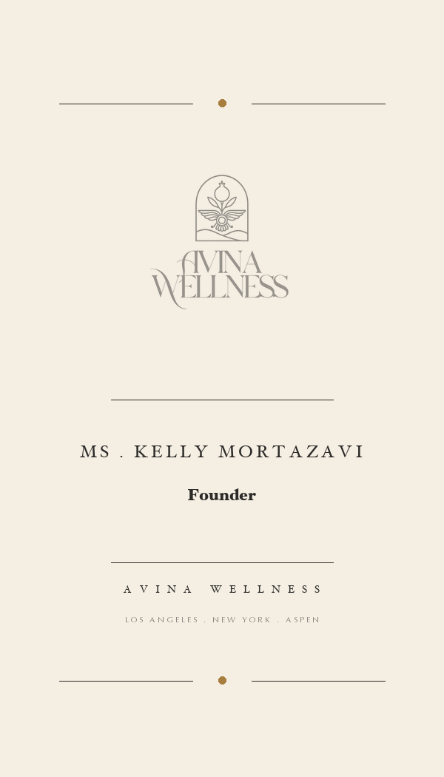
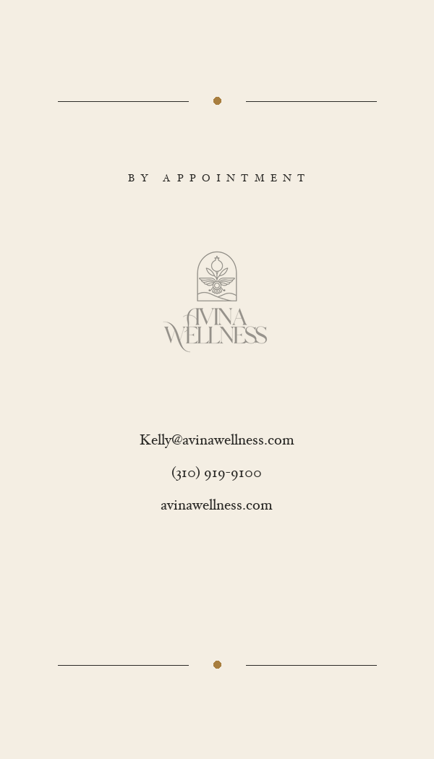
10
Engraved Classic
FRONT
BACK
What it does
Decorative hairlines top and bottom with an ochre dot center. 'MS . KELLY MORTAZAVI' in spaced caps. 'Founder' in italic. Cities listed at the foot. Reverse: 'BY APPOINTMENT' header, logo, contact.
Why
Old-world calling card. The format predates business cards by a century. Best of the set for the Failure-to-Launch Heir archetype: their parents will recognise this register instantly. Print on heavyweight cream cotton stock for the full effect.

Slide 16
Round 2
Your aesthetic, refined
Built from the directions you sent through.
Watercolor washes (blush + dusty grey). Bronze typography. Your portrait in an arched frame matching the
logo emblem. Decorative cross dividers. The warmth register.
Each of the six takes the same DNA in a different direction. Round 2 is the brand as you already see it.

Slide 17
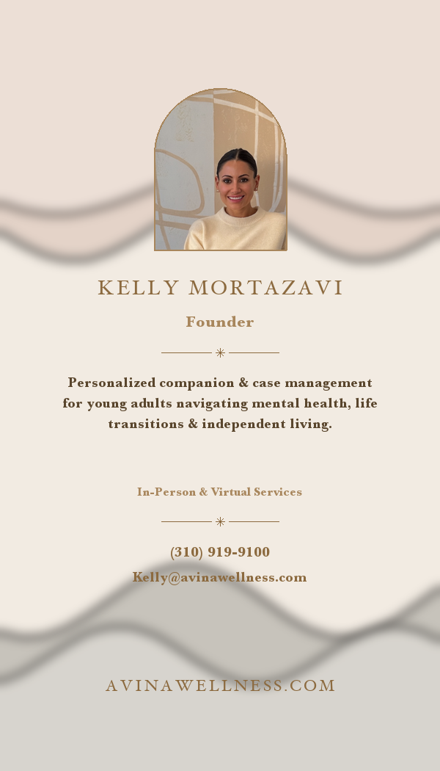
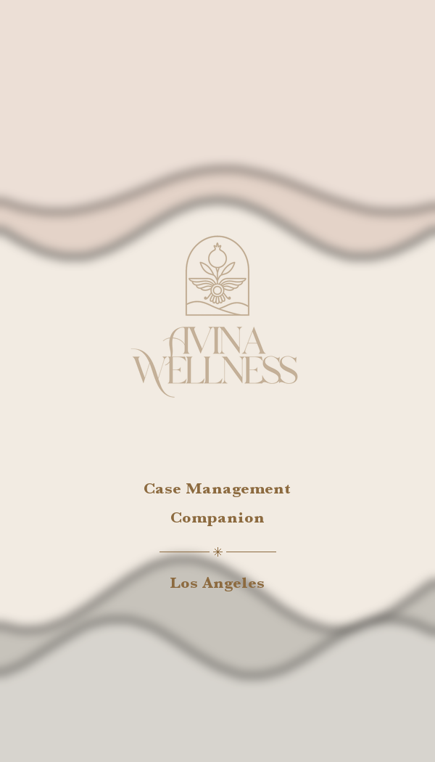
11
Kelly Anchor (refined)
FRONT
BACK
What it does
Closest direct refinement of your reference. Watercolor blush + dusty grey washes. Photo in arched frame matching the logo emblem shape. Bronze typography. Cross-and-line dividers. Full service copy and contact.
Why
Your aesthetic, polished. Same DNA as the cards you mocked up but with tighter type alignment, cleaner photo cropping, and the dividers locked to a consistent rhythm. The safest yes if you want to honour the direction you have already chosen.

Slide 18
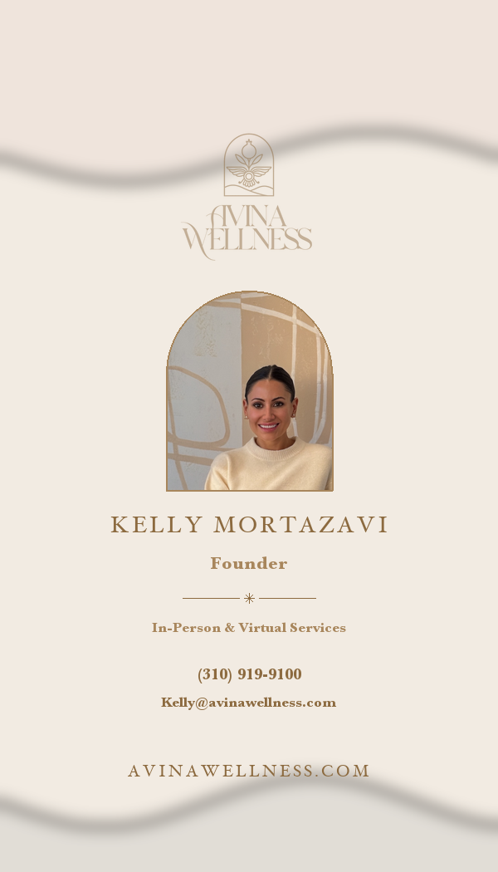
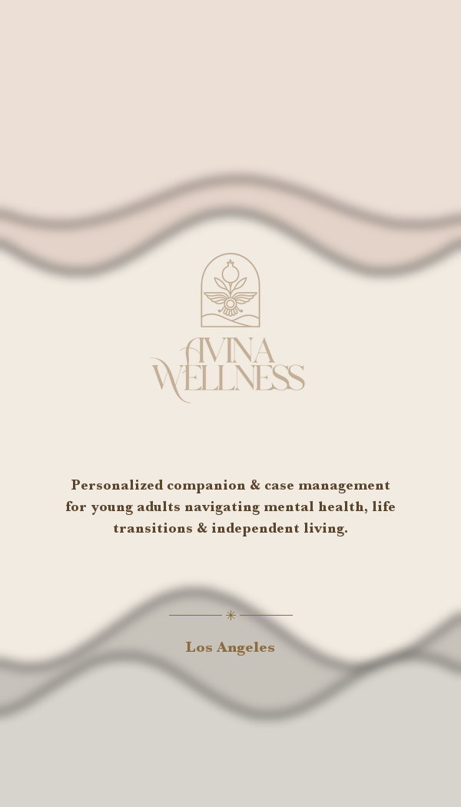
12
Watercolor Monochrome
FRONT
BACK
What it does
Single-tone refinement: only blush at top, only dusty grey at bottom, no overlapping mid-tones. Logo above the photo so the brand reads first. More restrained washes.
Why
If 11 is a touch too colourful, this pulls it back without losing the warmth. The single-tone discipline is what makes premium feminine brands (Aesop, Loewe) feel premium rather than busy.

Slide 19
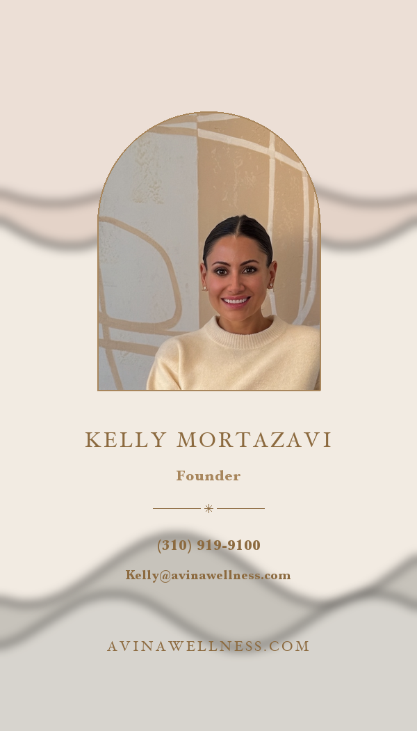
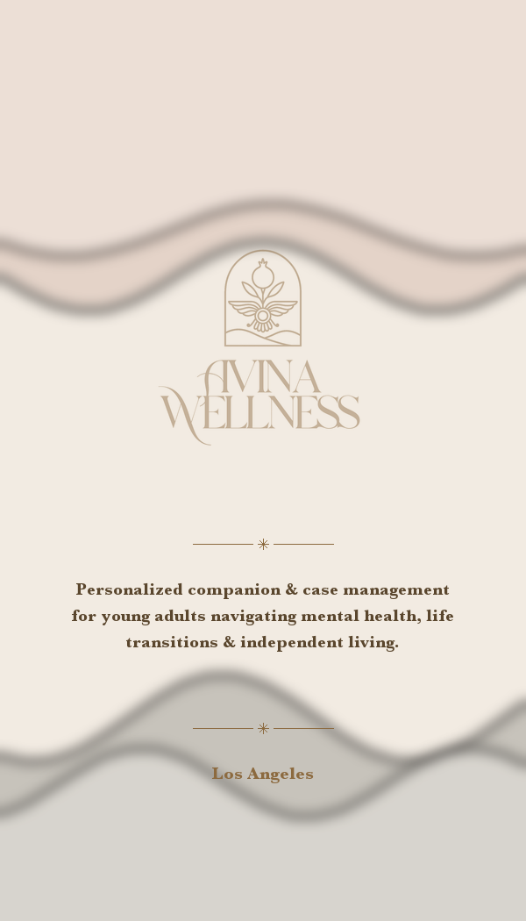
13
Photo Hero
FRONT
BACK
What it does
The photo is the largest element on the card. Minimal text below: name, role, phone, email. Reverse holds logo, service description, and the city.
Why
When you are doing the introducing in person, the card just needs to remember your face. This is the most personal direction. Best if your network grows by warm referral rather than cold pitch.

Slide 20
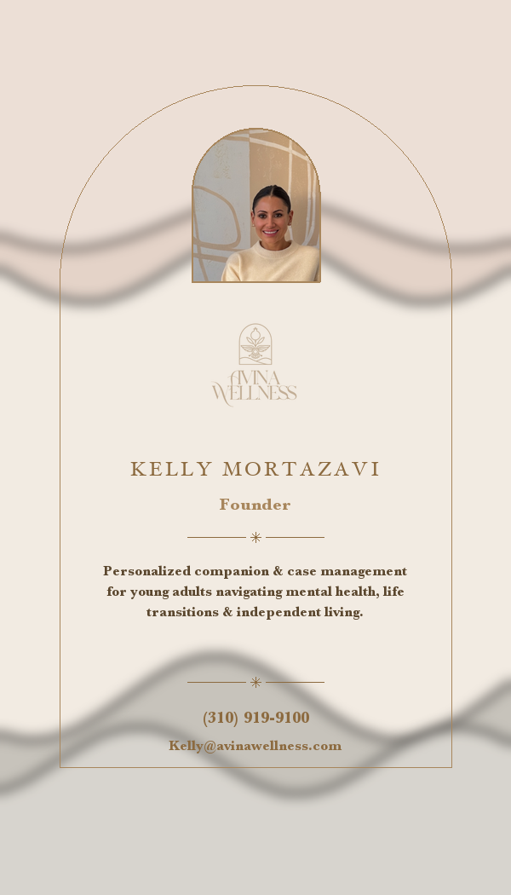
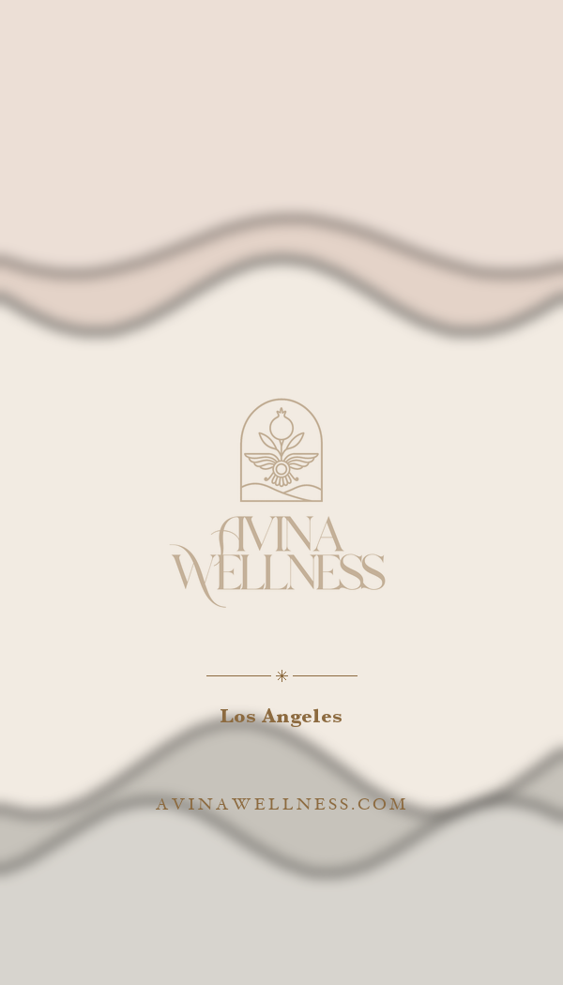
14
Arch Motif
FRONT
BACK
What it does
The arch shape from the logo emblem becomes the whole card's frame. Inside the arch: small photo, logo, name, service description, contact. The motif becomes ownable.
Why
Most distinctive direction in the entire set. Nobody else's card is shaped by their logo. This is the one that gets photographed by clients and shared. Risk: the arch is a strong commitment; you cannot unsee it once you choose it.

Slide 21
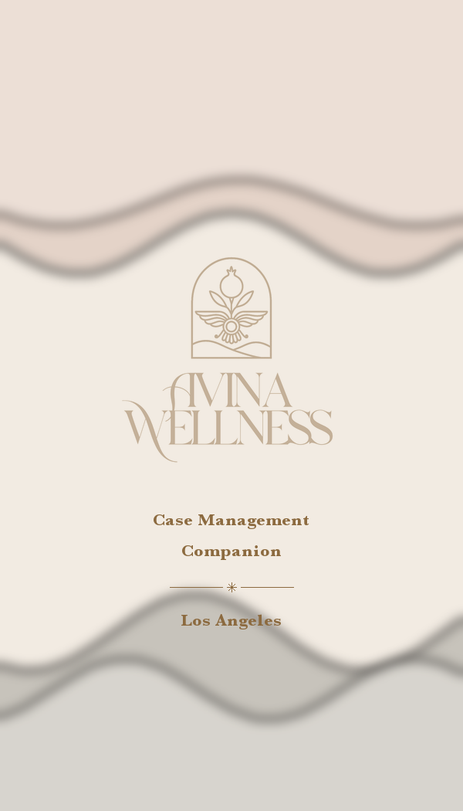
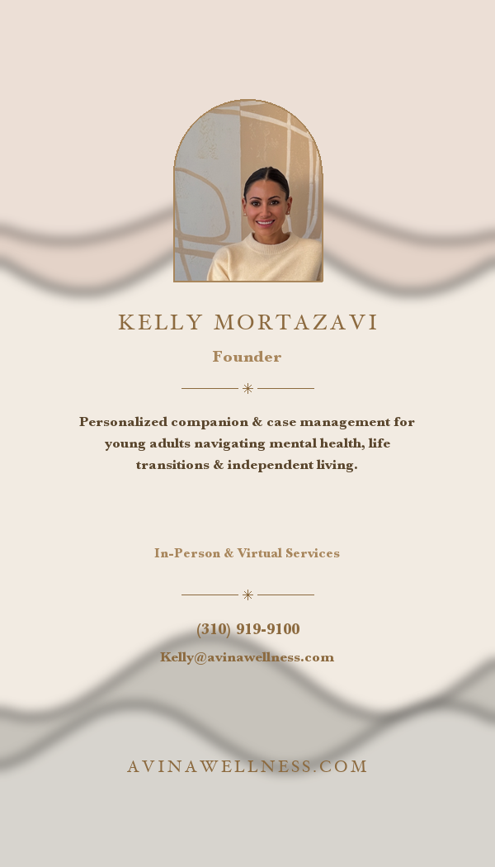
15
Brand-Mark Forward
FRONT
BACK
What it does
Front carries only the logo and 'Case Management . Companion . Los Angeles' on the watercolor wash. The full personal card (photo, name, contact, service description) is on the reverse.
Why
The brand introduces itself; you introduce yourself second. Useful when you want clients to know the firm before they know the founder. Pairs with the Round 1 Crest direction in spirit.

Slide 22
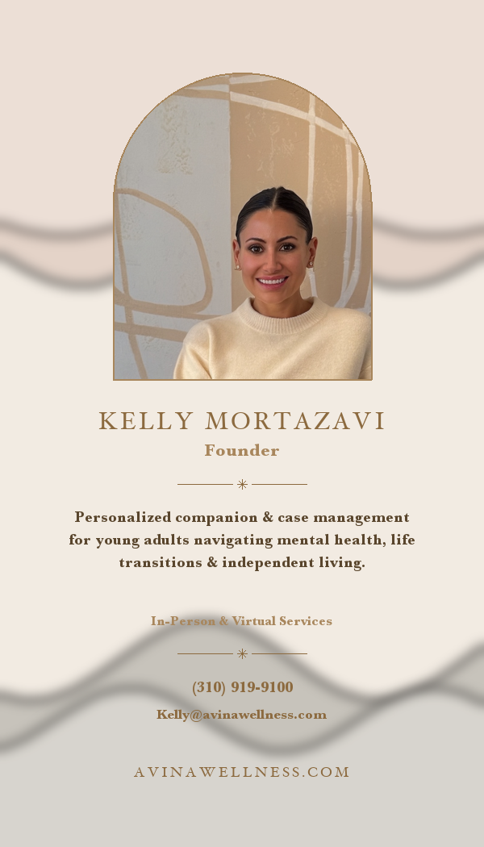
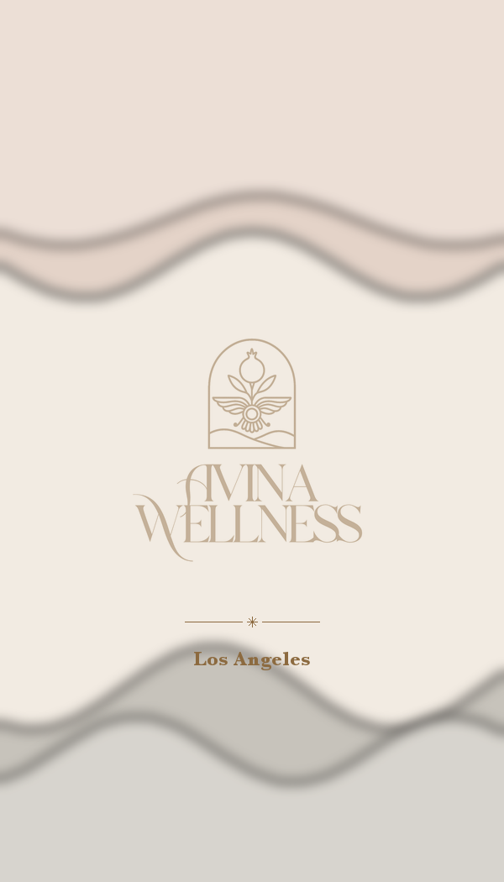
16
Editorial Portrait
FRONT
BACK
What it does
Larger photo top-center. Name as a strong serif statement below. Service copy, contact, and web stacked vertically. Reverse: logo + city only.
Why
Most magazine-cover of the six. Reads like an interview byline rather than a business card. Best for events where you are positioned as the speaker / the expert in the room.

Slide 23
Two registers, side by side
GRAVITAS REGISTER
WARMTH REGISTER
Discretion. Calm. Premium-by-restraint.
Personal. Approachable. Recognisably you.

Slide 24
Recommendations and next steps
Top picks if you want to lock one in today
11 Kelly Anchor
Closest to your reference. Photo + service copy + bronze typography. The safest yes.
14 Arch Motif
Most distinctive. The arch from the logo emblem becomes the whole card.
13 Photo Hero
Largest photo. Lets you do the introducing without having to read copy.
01 Calling Card
If you want the gravitas register: the quietest, most private-office of the ten.
Once you choose
1. I prep print-ready files at 3.5" x 2" with 0.125" bleed, CMYK, 300 dpi.
2. We refine: photo, wash colour, type weight, anything you want adjusted.
3. Recommended printers: Moo (Luxe stock, soft-touch), VistaPrint Premium (US), or a local LA letterpress shop for the Round 1 directions.
4. All sixteen are also live as an editable Canva design so you can play with text, swap photos, change wash tones yourself.

Slide 25
Take your time
Tell me which direction feels right and we will refine from there.

